Slide 1


Predicting H-Adsorption Energy Using BE-CGCNN for HEA Discovery
By Kuneh Shah
ESEP-G 2025 {June24 2025 –August1 2025}
And PHN – 499 {Training Seminar}, Dept of Physics IITR
Supervisor: Prof. Watanabe Satoshi
Second Supervisor: Asst. Prof. Lu Augustin

Slide 2
Workflow
What is a High Entropy Alloy?
Why Machine Learned Interatomic Potentials?
1
Introduction and Objective
How does the model parameters and its structure influence its predictions?
How does training data impact the model’s performance?
2
Methodology
Which physical factors affect model accuracy?
Investigating the best accuracy possible for the given dataset.
3
Results
Some Limitations and Challenges.
Avenues for further improvement.
Possible applications in the real world…..
4
Conclusion and Outlook

Slide 3
Introduction
What are High Entropy Alloys? And why the name?
5 or more principal metallic elements in roughly equal proportions.
Creates a wide-array of adsorption sites + “cocktail effect”
Usage in Hydrogen Evolution Reaction.
Why use machine learned interatomic potentials?
Low computational cost
Higher flexibility
Ability to simulate larger, more complex systems (slabs, clusters etc.…)
Notes:
What are High Entropy Alloys?
A class of metallic materials characterized by containing 5 or more distinct elements in roughly equimolar proportion this leads to higher possibilities of atomic arrangements and thus higher configurational entropy hence the name. (although I worked on clusters with less than 5 elements as well which can be extrapolated to HEA clusters)
The multitude of elements in HEAs creates a wide array of adsorption sites with varying binding energies, allowing for more efficient interaction with reactants and intermediates
“cocktail effect”- the synergistic interplay of multiple elements that leads to enhanced properties beyond what would be predicted by simply averaging the properties of the individual elements
The wide array of adsorption sites with varying binding energies, combined with the high thermodynamic stability of these clusters, makes them promising candidates for investigation as catalyst materials for the Hydrogen Evolution Reaction (HER) and other adsorption-driven catalytic processes.

Slide 4
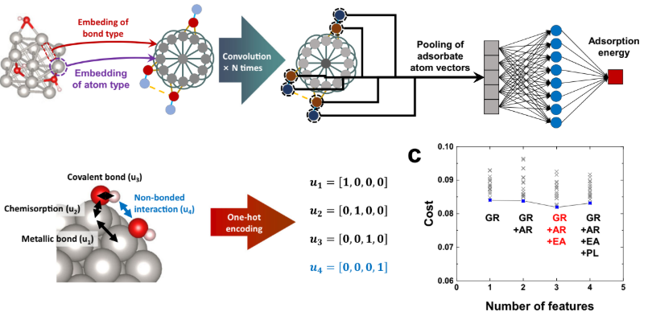
Objectives
BE-CGCNN model [1] proposed embedding of bond-type between the atoms within the cluster as edge feature along with group number, atomic radius, and electron affinity as node features.
[1] K. Bang et al., Nat. Commun., 14, 3004 (2023)

Slide 5

Objectives
The original paper dealt with single element nanoparticles using a fixed cutoff distance. Instead we used element-specific cutoffs.
What do I do then❓
My job was to analyse and understand the nitty-gritties of the performance
of this new model under various parameters and conditions.
Ascertain the best prediction accuracy achievable by the model with a fixed dataset.
Incorporate external differentiating features among the training data to better understand the trends in the model’s prediction accuracy.
Notes:
….element specific cutoffs enabling us to use it to simulate 2,3,4 element clusters and more. Also high entropy alloys.
Once the model is made using innovative ideas ( i.e all the smart stuff is done ) : we are left with the seemingly boring work of analysing. Yet, shit needs to be done

Slide 6
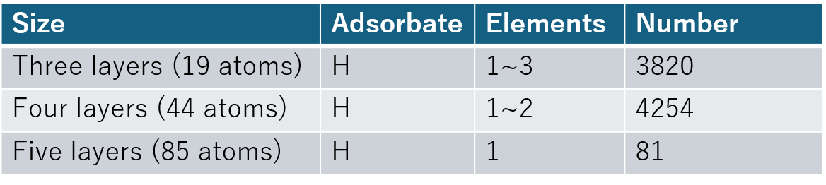
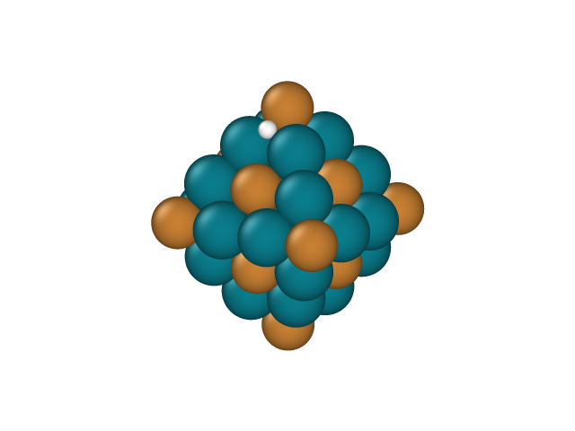
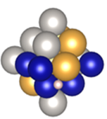
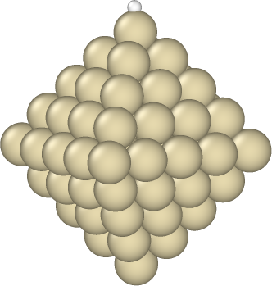
Methodology
Overview of the dataset used for Training and Testing the model
Octahedrons (in-house)
Ag, Au, Co, Cu, Ir, Ni, Pd, Pt, Rh are used.
Three layers
Four layers
Five layers
Internal Testing Data
Validation Data
Internal
Training
Data
To clarify!
Training Data

Slide 7
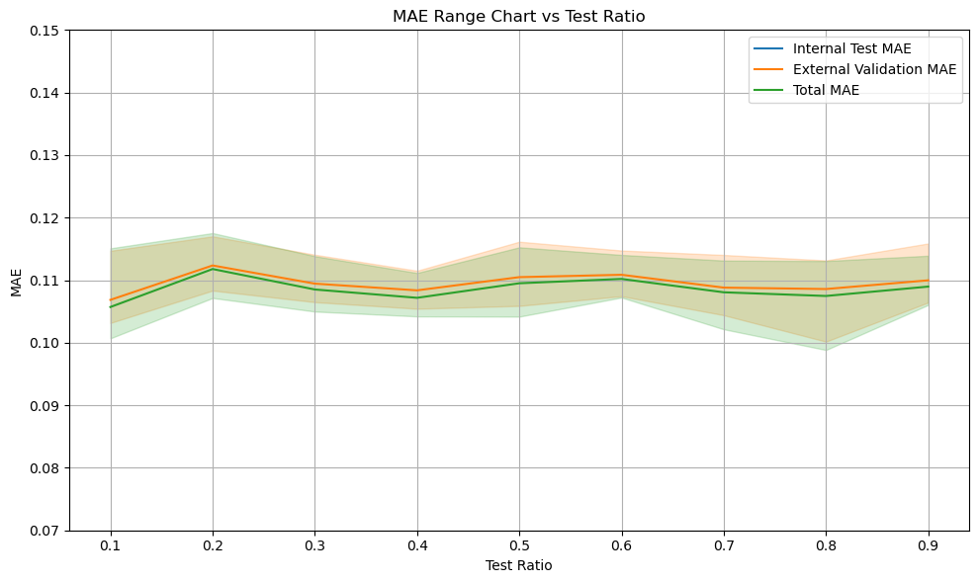
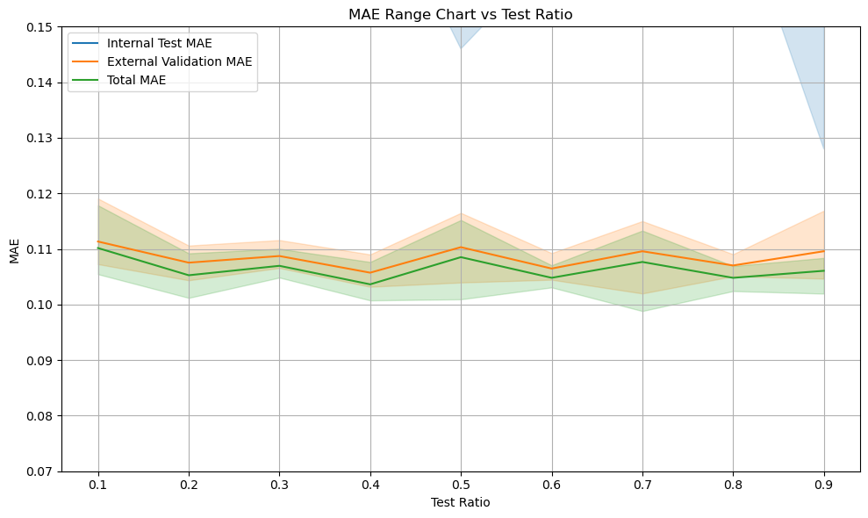
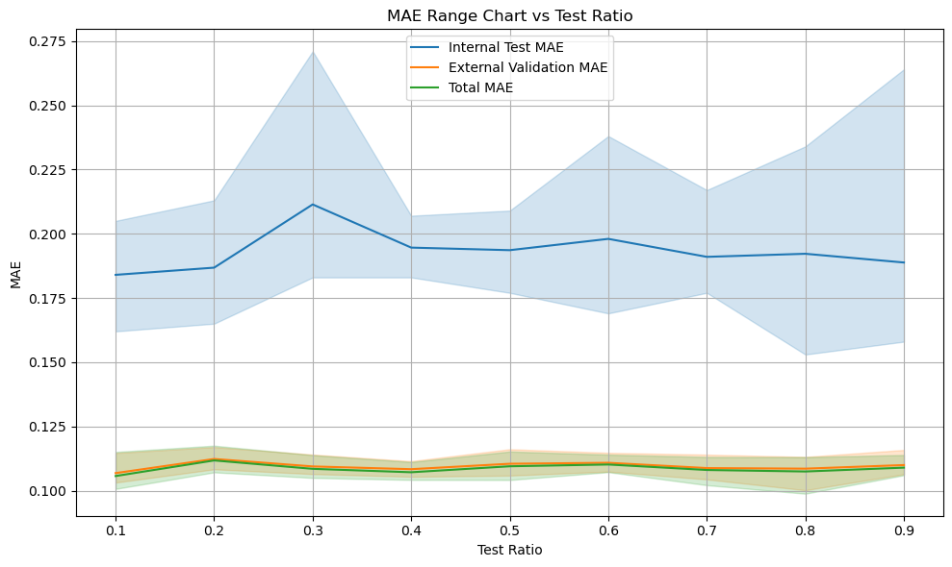
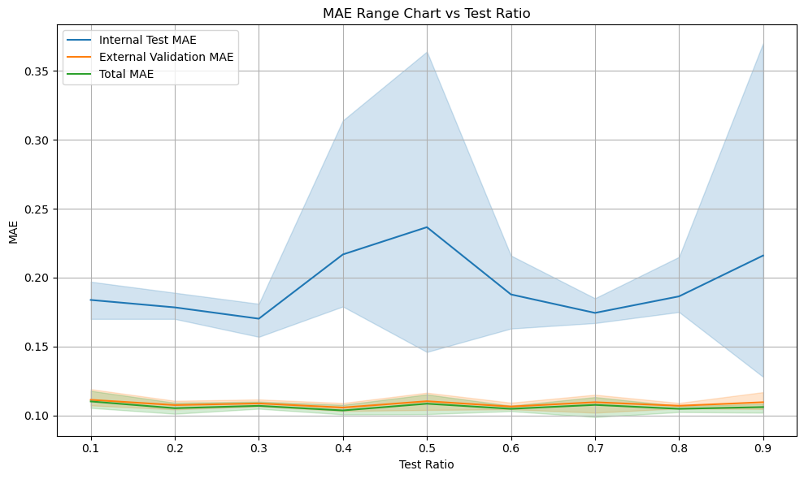
Test ratio
3-layered clusters
1910 (3-layered clusters) each in Training Data and Validation Data
100 epochs each; validation = 5 times ; constant learning rate of 0.001, batch size = 16
4-layered clusters
2127 (4-layered clusters) each in Training Data and Validation Data
100 epochs each; validation = 5 times ; constant learning rate of 0.001, batch size = 16
Notes:
We observe that over the 5 runs, there is not much variation in the accuracy of the model when it comes to the validation data. Hence, in order to ensure efficient learning we keep the test ratio=0.8 (so that the model has enough data to learn)

Slide 8
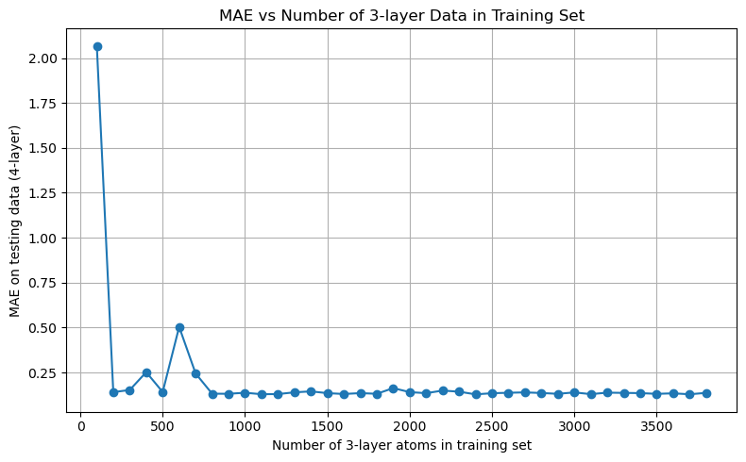
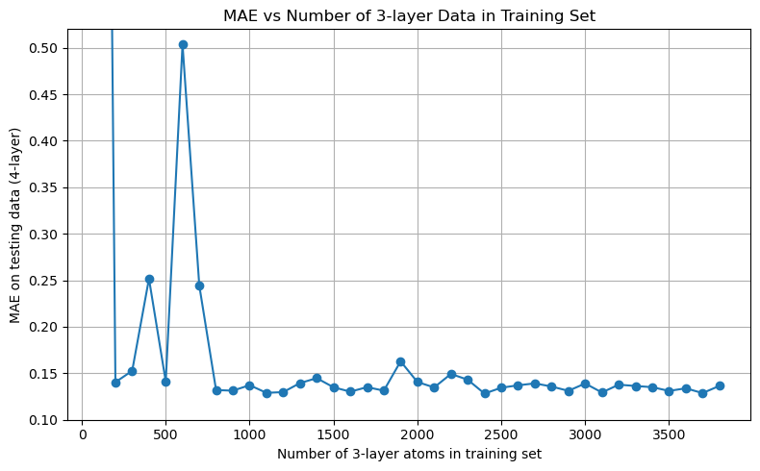
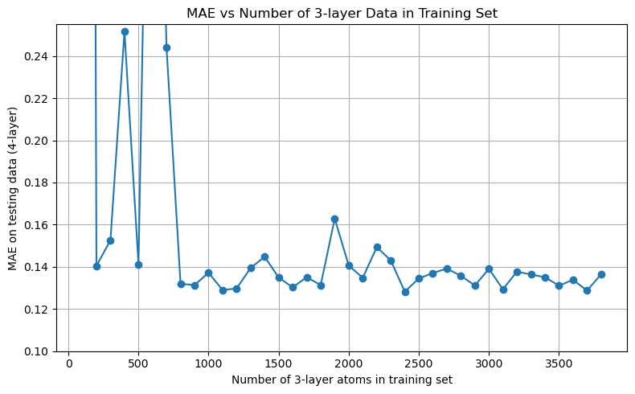
Minimum data required to get appreciable prediction accuracy;
Sets of Internal training data selected with 3-layered and 4-layered clusters.
(a) 100 (3-layered clusters):30(4-layered clusters) in training data and 30(4 layered clusters) in validation data
(b) 200(“ “): 60(“ ”) in training data and 60(“ “) in validation data
:
:
(z) 3800(“ “):1140(“ “) in training data and 1140(“ “) in validation data
Mean Absolute Error of predictions on validation data plotted
All clusters chosen randomly
No overlap in Training and Validation Data
No of Epochs : 100 per iteration
Test Ratio : 0.8 (Within Training Data)
Notes:
Hence, now the minimum required data for training the model has been set as 1300 (1000+300)

Slide 9
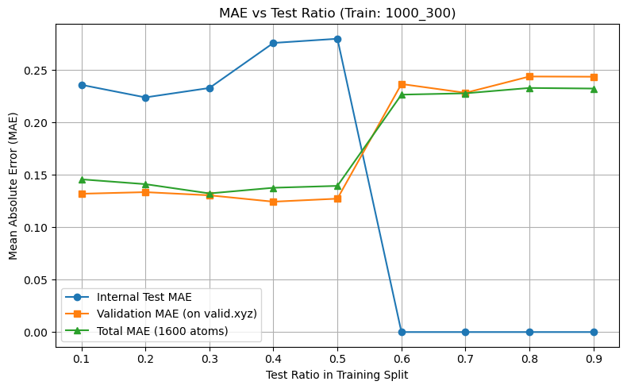
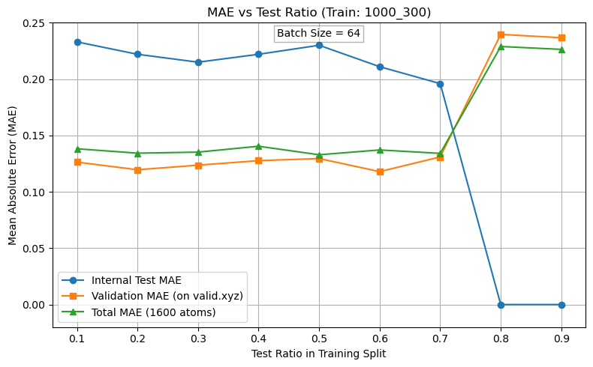
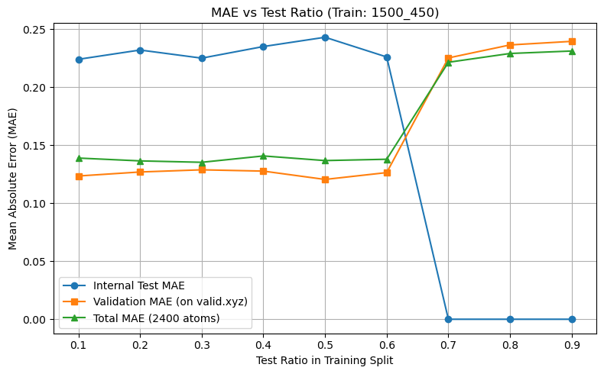
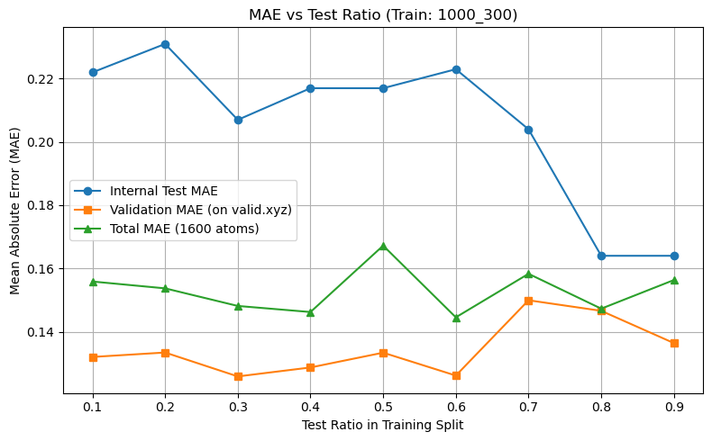
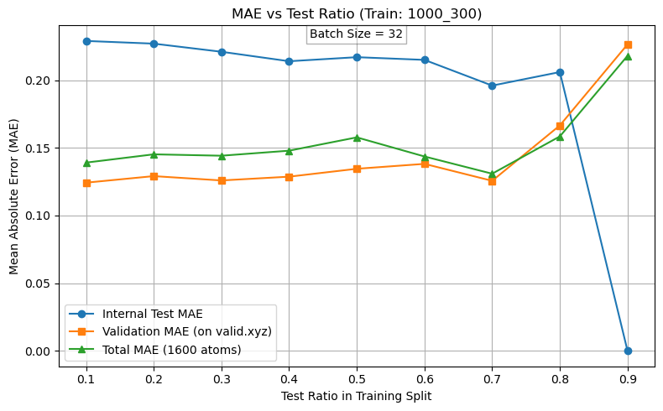
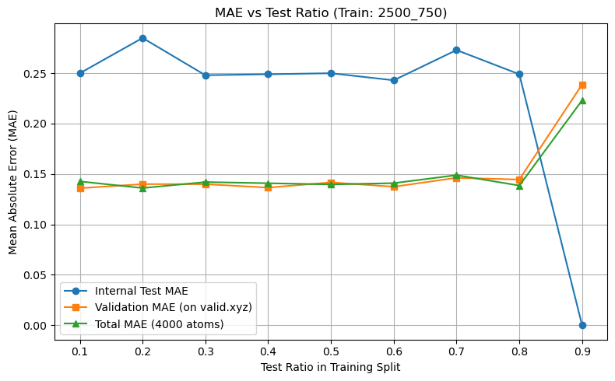
a
Here, I encountered a problem!
Solution? Decrease the batch size
d
b
Learning rate = 0.01
250 Epochs each
Batch Size = 16
c
Notes:
With increasing dataset size, the internal testing MAE drops to 0 and the validation MAE increases significantly; at higher test ratio values. – probably because of overfitting.
(a) (b)(c) kya hai? 1000 3 layer 300 4 layer in training and 300 in validation and so on…….

Slide 10
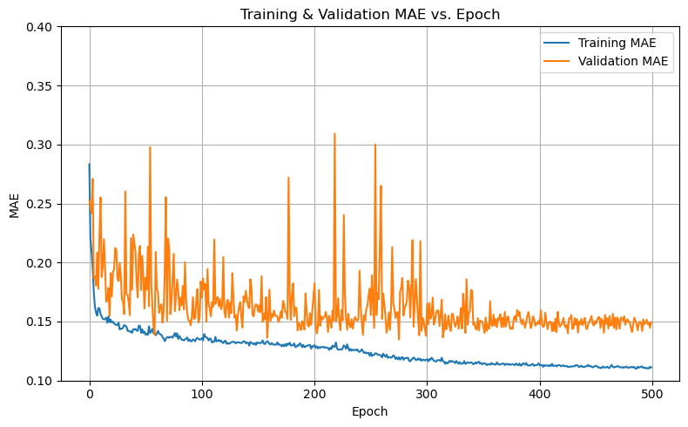
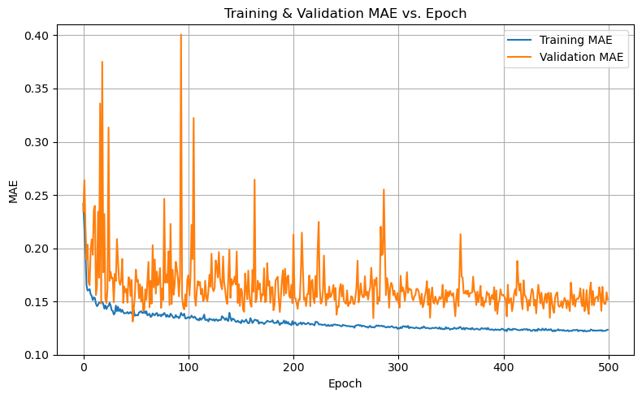
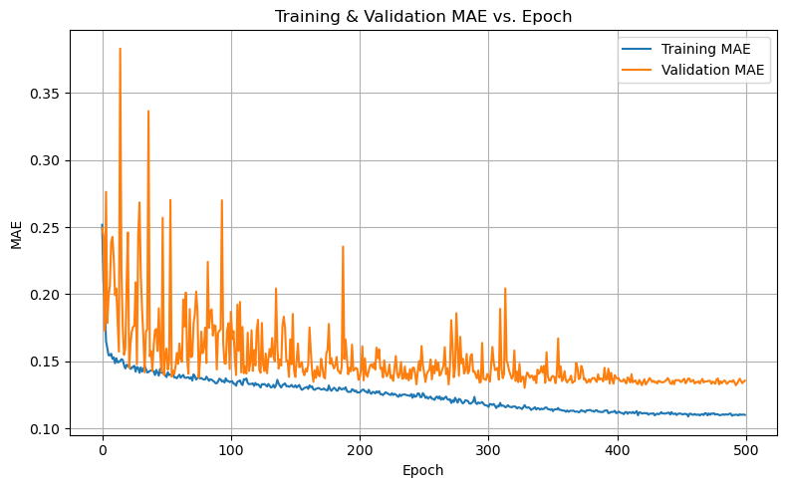
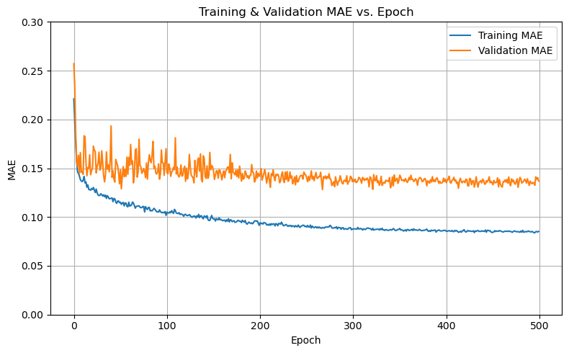
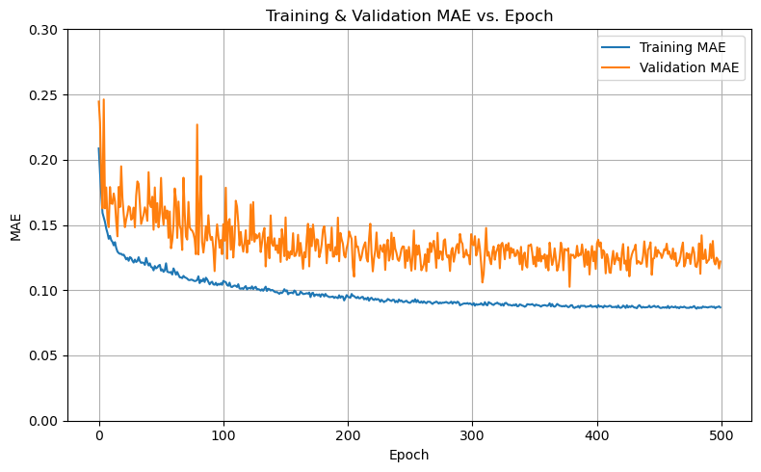
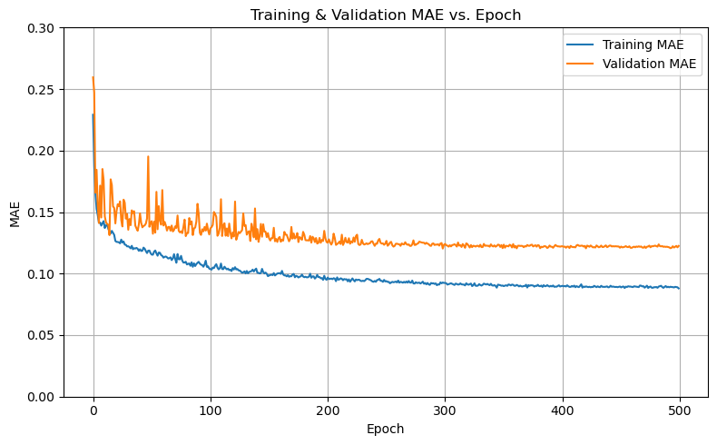
Choosing the right number of Epochs
a
b
c
Notes:
Reducing the learning rate from 0.01 to 0.001 led to a noticeable decrease in both training fluctuations and mean absolute error (MAE). This behavior is likely due to the smaller learning rate allowing the optimizer to make more controlled, gradual updates, enabling the model to settle into a better local minimum with reduced oscillations. Also the MAE stays more or less constant after 250 epochs.

Slide 11
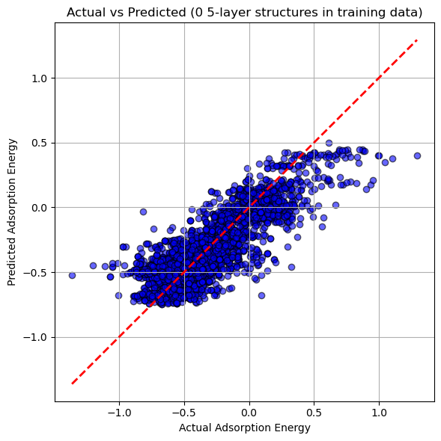
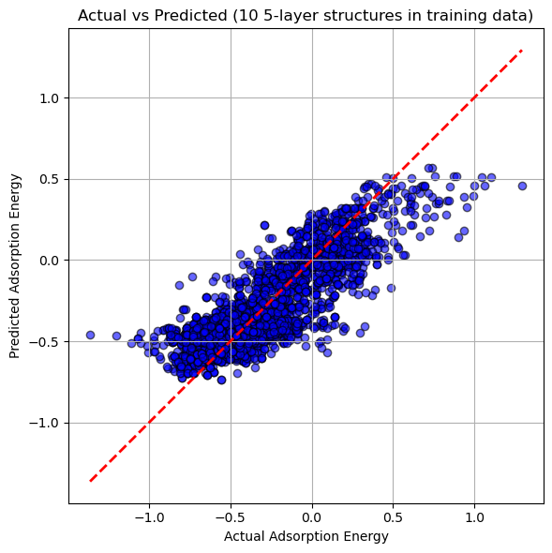
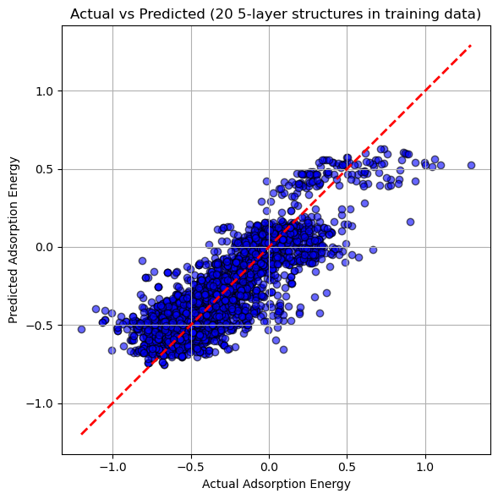
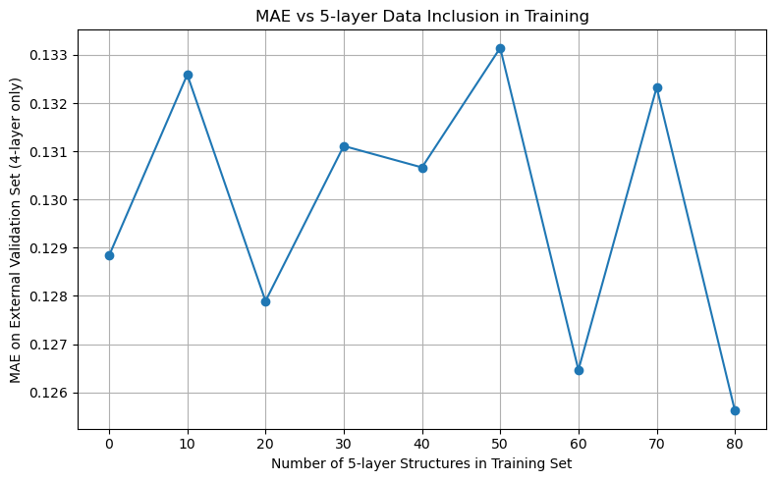

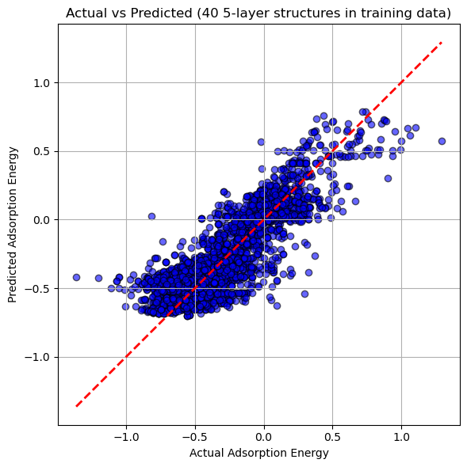
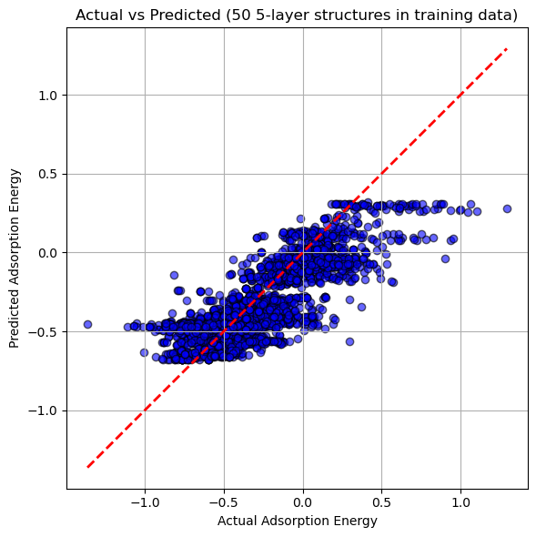
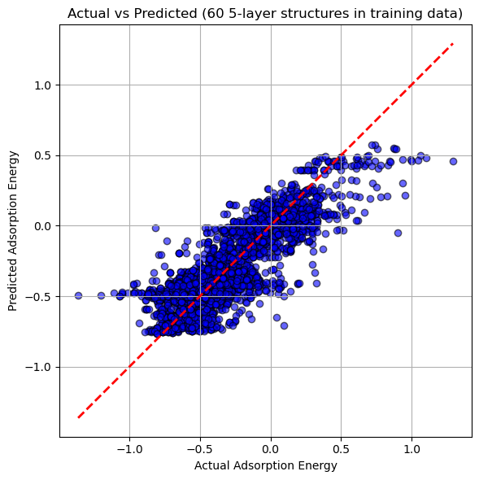
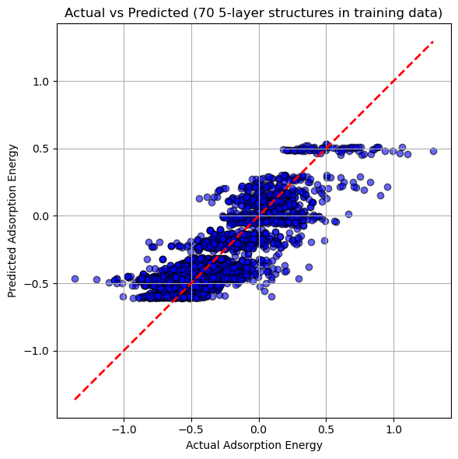
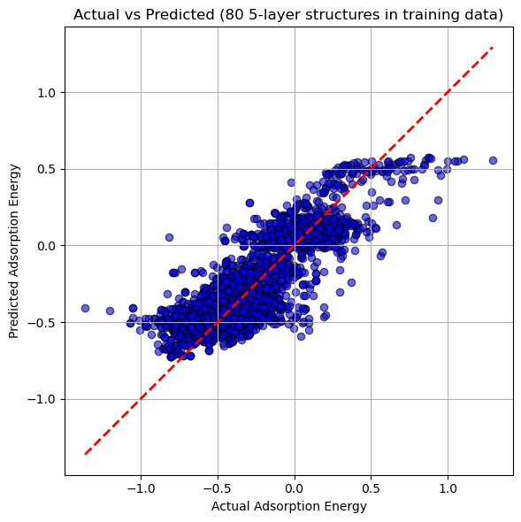
Incorporation of 5-layer clusters in training data
Data | 3 – layer | 4 – layer | 5 – layer
Training | 1000 - x | 300 | x
Validation | 0 | 3954 | 0
Learning rate = 0.001
100 Epochs each
Test ratio = 0.8
Average time : 56.6 sec per iteration
MAE = 0.129
MAE = 0.133
MAE = 0.128
a
b
c
f
h
b
MAE = 0.131
MAE = 0.131
MAE = 0.133
d
e
d
e
f
a
MAE = 0.126
MAE = 0.132
MAE = 0.126
c
g
i
g
h
i
Notes:
Even though 250 epochs is ideal, I took 100 epochs to save on time. As we can see there is not a significant improvement in accuracy on addition of 5 layer data probably because of only 80 clusters available which might not have had much impact on the accuracy. An interesting thing we observe is the existence of quantisation as shown by the red circles. Hence next, I investigated the source of the same.

Slide 12
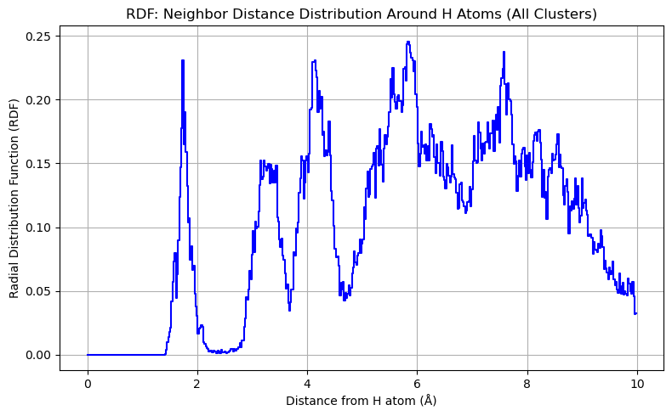
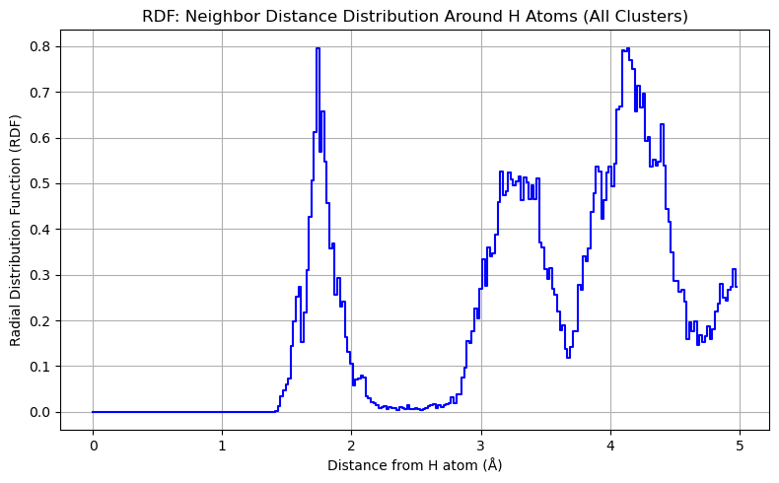
Finding the Ideal cutoff distance for calculation of coordination numbers
Using the default cutoff distance, I encountered coordination numbers of H atoms as high as 8. Hence I plotted the
RDF plot for the H atoms in all clusters of my Validation set
2.38Å
Cutoff Distance
**The y-axis differs because its
unit represents probability.

Slide 13
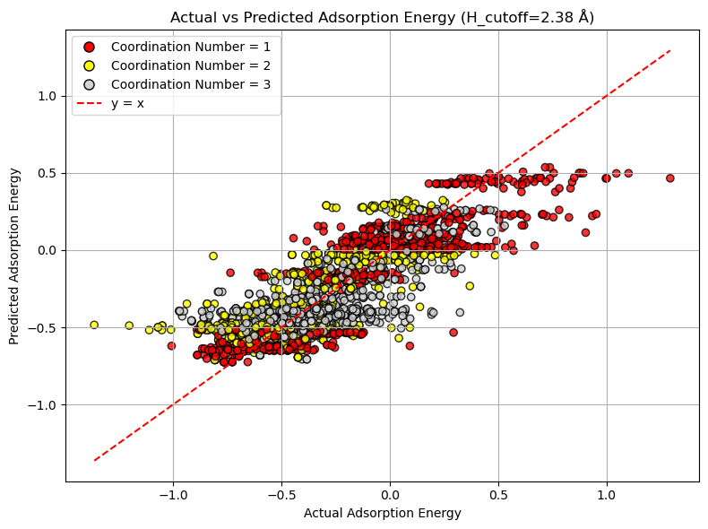
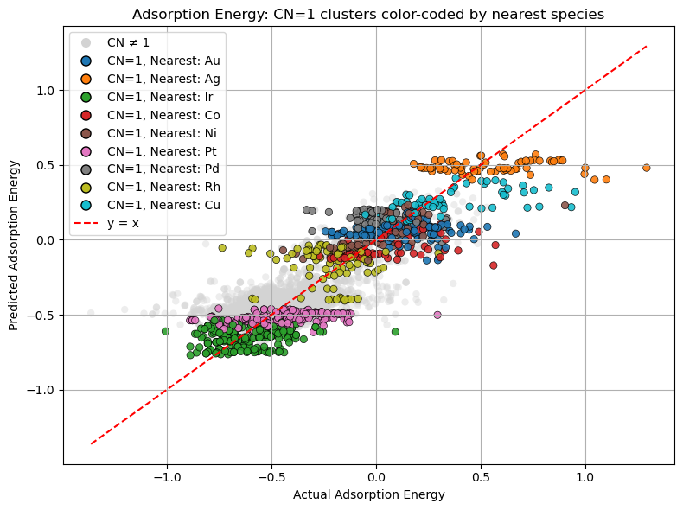
Step-1
Step-2
Dive deeper into the properties of these cn1 clusters:
Why the quantization?
Is there any pattern?
If so how to mitigate this?
No 5-layer clusters in
training data (MAE = 0.133)
250 epochs, lr=0.001, batch size = 16, test ratio =0.8
The contribution to quantization is primarily driven by H atoms with coordination number = 1 (cn1), typically positioned at apex sites.
250 epochs, lr=0.001, batch size = 16,
test ratio =0.8

Slide 14
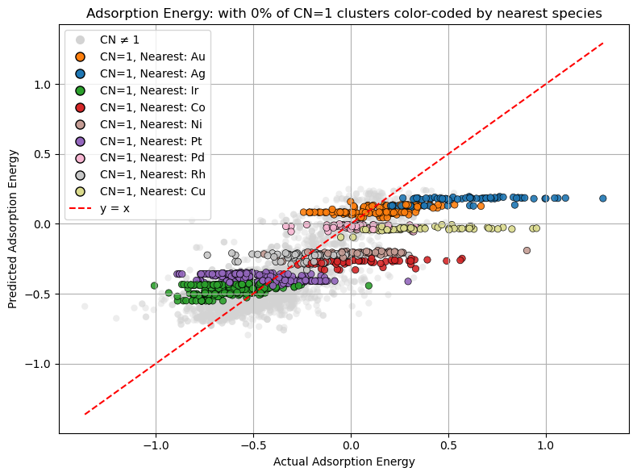
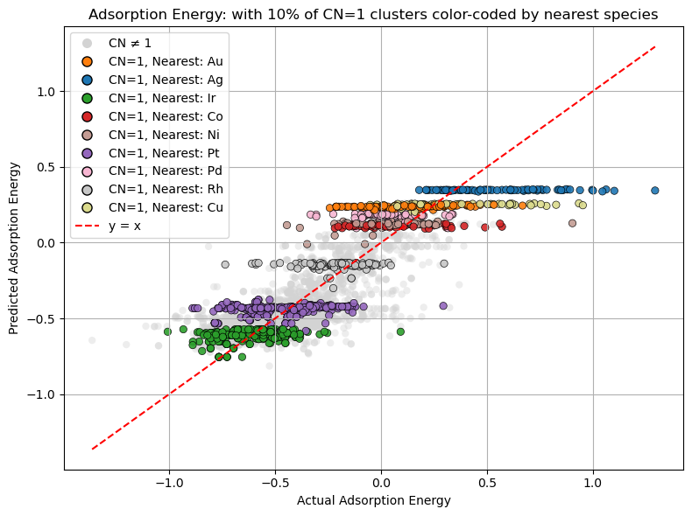
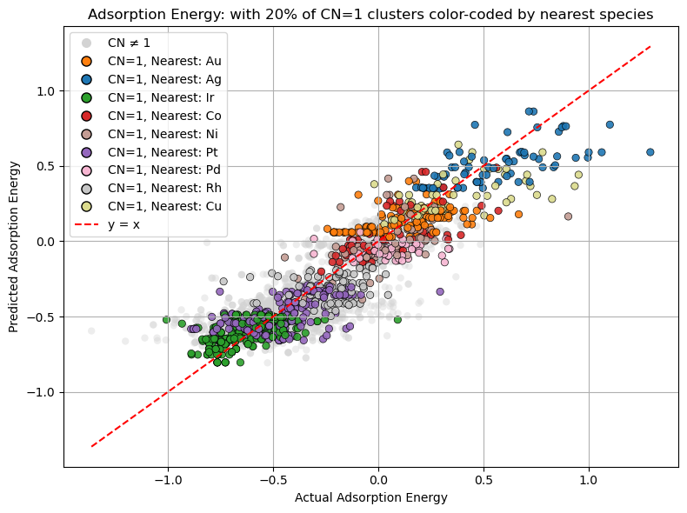
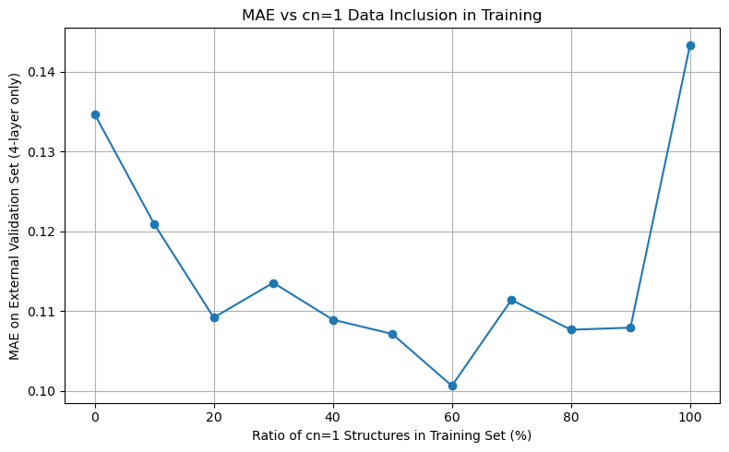
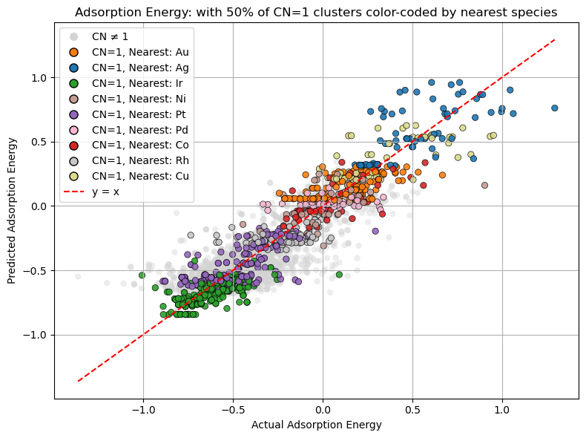
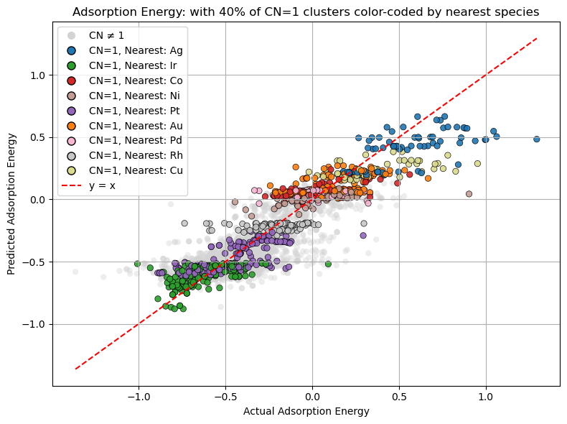
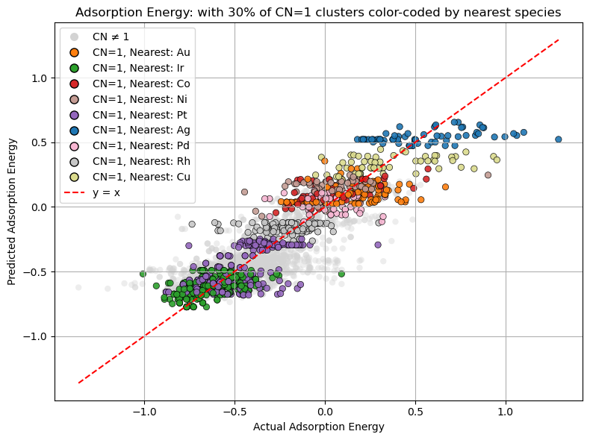
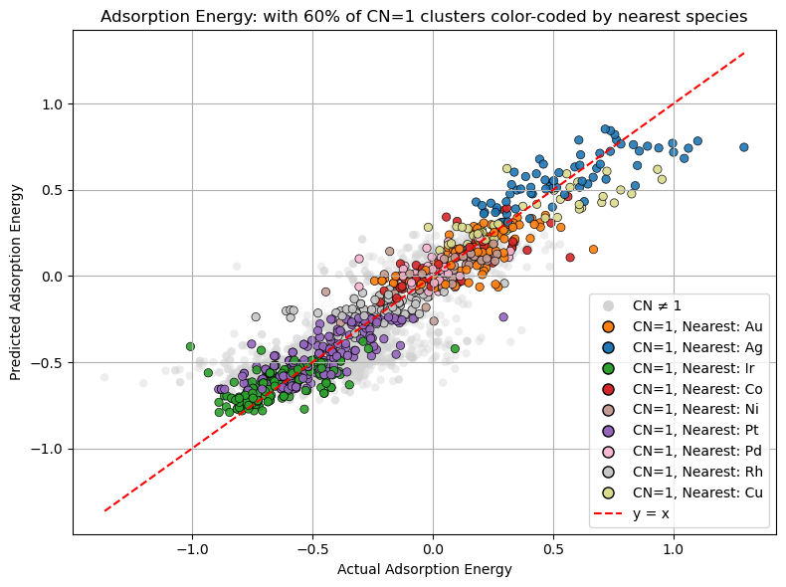
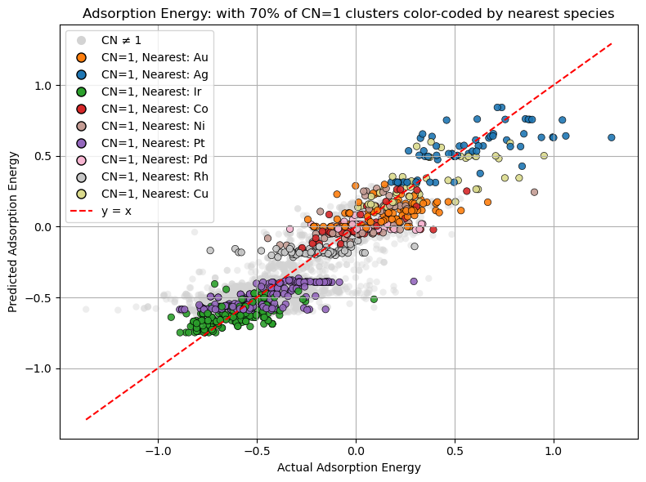
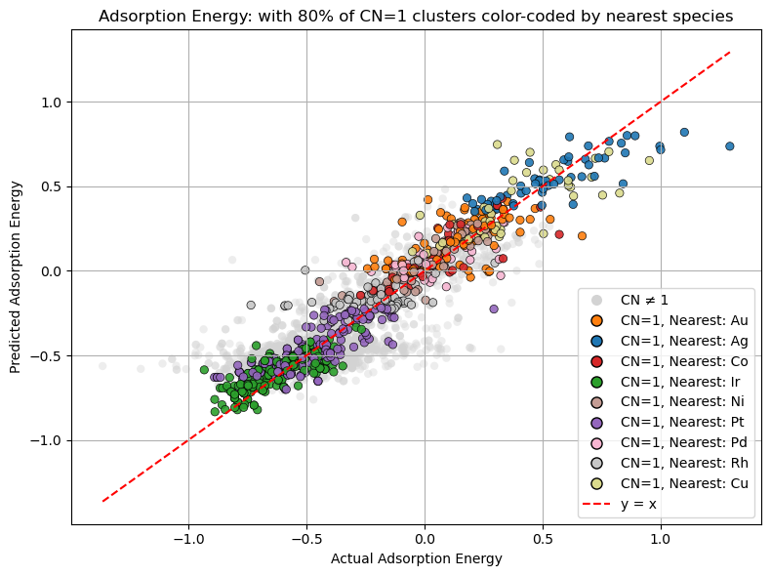
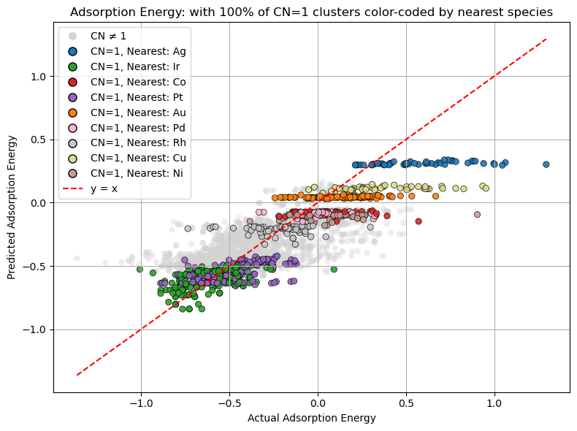
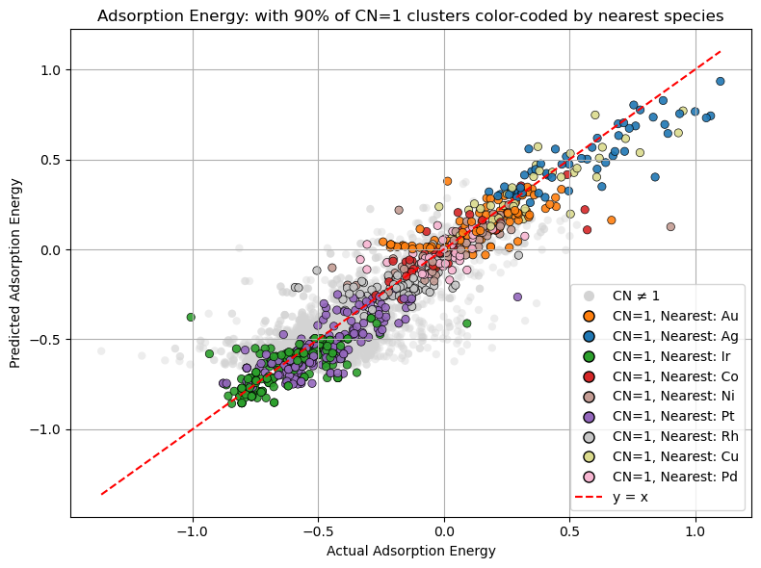
Best Prediction accuracy at 60%.
At 60%, cn1 clusters seem to be more or less predicted accurately barring a few outliers and quantization has been removed.
To check for the source of error, cn2 clusters were analyzed
100 epochs each;
Lr=0.001
Batch size =16
Test ratio =0.8
Notes:
The ratio of cn1 clusters were manually set at x % of the training data to check if there is any improvement in accuracy/ removal of quantisation.

Slide 15
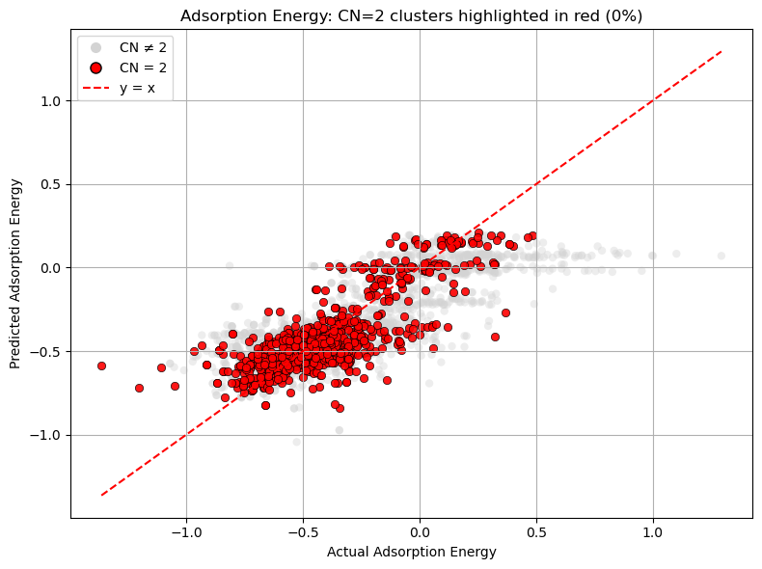











As expected, the increase in MAE can be attributed to the reduction in amount of cn2 clusters in the training data.
Which has resulted in the trend of increasing MAE (for cn2).
Overall, no significant change in prediction accuracy observed with changing percentage of cn1 clusters in training data.
100 epochs each;
Lr=0.001
Batch size =16
Test ratio =0.8
Notes:
Overall,no significant change………..
The increase in prediction accuracy of cn1 clusters is offset by the decrease in cn2 clusters.
So…what next? I tried to analyse any improvement in prediction accuracy on changing the convolutional layers.

Slide 16





Variation in MAE with number of convolutional layers
250 epochs
Lr=0.001
Batch size=16
Test Ratio =0.8
No of Cn=1 clusters = 60% of training set
CN=1 clusters in red
CN=1 clusters in red
186.89s
187.79s
CN=1 clusters in red
CN=1 clusters in red
207.69s
217.30s
No evident improvement in
prediction accuracy
CN=1 clusters highlighted in red

Slide 17




Cutoff Distance = Atomic Radius
Cutoff Distance = Atomic Radius*1.5
Cutoff Distance = Atomic Radius*2.5
90.32s
91.12s
157.11s
MAE=0.123
MAE=0.126
MAE=0.173
Cutoff Distance = Atomic Radius*5
188.00s
MAE=0.182
Discussion:
There is a decrease in quantization owing to the next-to-nearest atom information but also a decrease in prediction accuracy
100 epochs
Lr=0.001
Batch size=16
Test Ratio =0.8
No of Cn=1 clusters = 10% of training set
Changing the cutoff distance for all atoms
Conv layers= 3
Notes:
Since a differentiation between the cn1 clusters was observed when cutoff distance for all atoms was increased, what would happen if the same was applied to the lowest MAE case (60%)

Slide 18





Cutoff Distance = Atomic Radius*0.5
Cutoff Distance = Atomic Radius
Cutoff Distance = Atomic Radius*1.5
195.93s
192.18s
199.71s
MAE =0.224
MAE =0.100
MAE =0.116
Cutoff Distance =Atomic Radius*2.5
Cutoff Distance = Atomic Radius*5
263.18s
294.32s
MAE=0.107
MAE =0.114
250 epochs
Lr=0.001
Batch size=16
Test Ratio =0.8
No of Cn=1 clusters = 60% of training set
Changing the cutoff distance for all atoms
Conv layers= 5
Notes:
As expected, the adsorption energy predictions no longer work when atomic radius is reduced to half (essentially deleting all the bonds). But there is no improvement yet in the MAE nor a trend. So, I incorporated specific cutoff for the H atom only as seen in the next slide.

Slide 19




Cutoff Distance = Atomic Radius
Cutoff Distance = Atomic Radius*1.5
Cutoff Distance = Atomic Radius*2.5
192.18s
193.62s
193.01s
MAE =0.100
MAE =0.097
MAE =0.096
Cutoff Distance = Atomic Radius*5
Cutoff Distance = Atomic Radius*10
203.51s
183.72s
250 epochs
Lr=0.001
Batch size=16
Test Ratio =0.8
No of Cn=1 clusters = 60% of training set
Changing only the cutoff distance
for hydrogen
Conv layers= 5 (Increased to ensure
fitting after increased number of connections)
MAE =0.104
MAE =0.099
Notes:
MAE = 0.096eV is the best prediction accuracy achieved so far which is ~3.3% of the total range (~3eV). Still not good but I believe it is the most optimum given the fixed dataset.

Slide 20
Results
Did not get a significant improvement in the prediction accuracy of the model by changing the model parameters/training data characteristics BUT…..
Found out the model’s behavior towards different classes of training data (coordination numbers, nearest atoms etc….)
Found the optimum parameters for the model given the present dataset.
Found out the influence of hyperparameters and cutoff distances on the prediction accuracy of the model.
Gained in-depth knowledge of various packages such as ASE, plotly, torch etc…

Slide 21
Conclusion and Outlook….
The very next task could be incorporating active learning in order to find its differential advantage over random learning for this model and by extension achieving this accuracy with a smaller training dataset.
Use universal MLPs to expand the present training dataset as well as for benchmarking.
Incorporating preferential weights for certain bonds (H-metal) by the way of Graphical Attention Network.
Or scaling the one-hot encoding method for that particular bond type.
Or Both?

Slide 22










Thank you everyone ☺

